Slide 1
Cub Arts Direction

Slide 2
Cubic

Slide 3

Cub Arts Direction Cubic

Slide 4
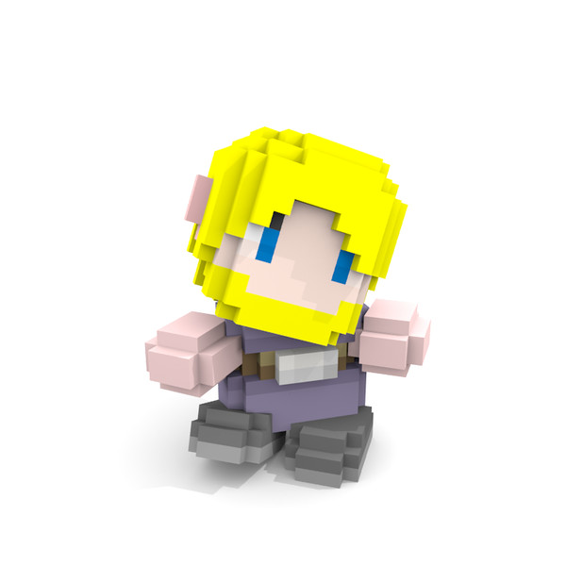
Cub Arts Direction Cubic

Slide 5
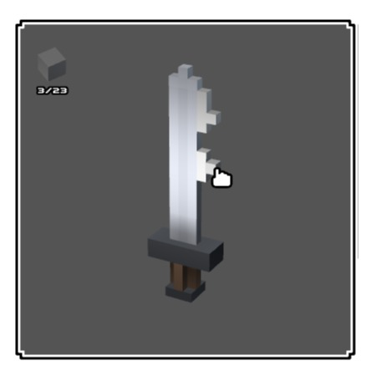
Cub Arts Direction Cubic

Slide 6
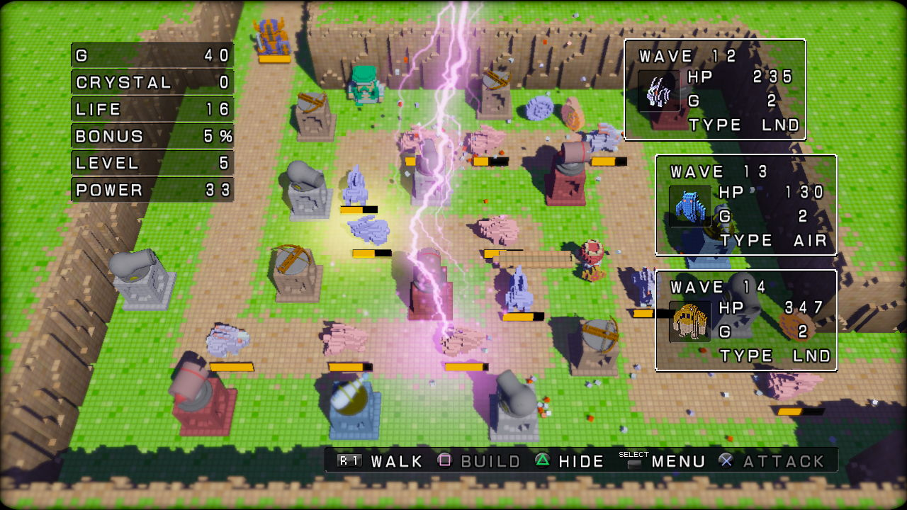
Cub Arts Direction Cubic

Slide 7
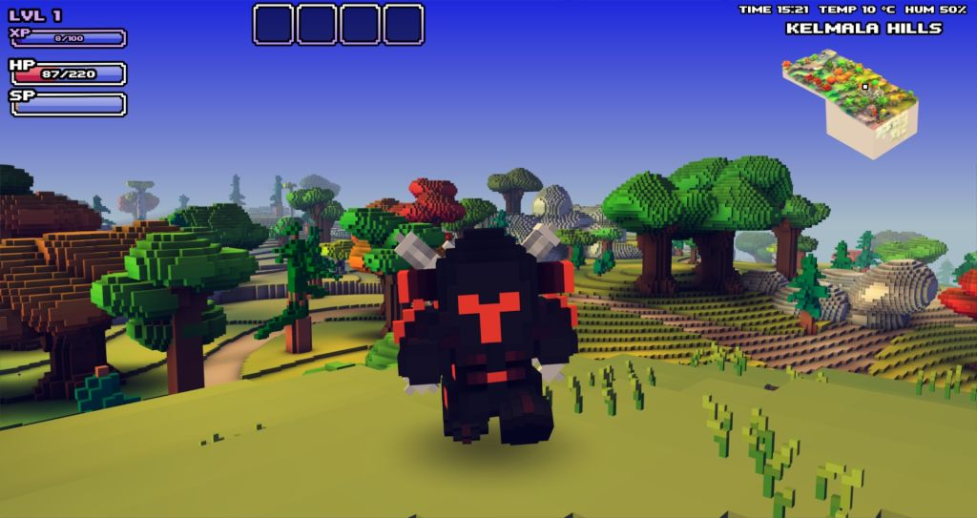
Cub Arts Direction Cubic

Slide 8
SD

Slide 9
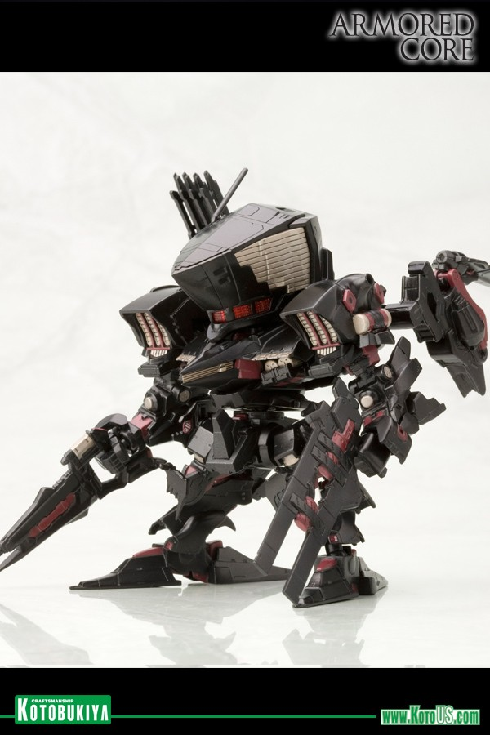
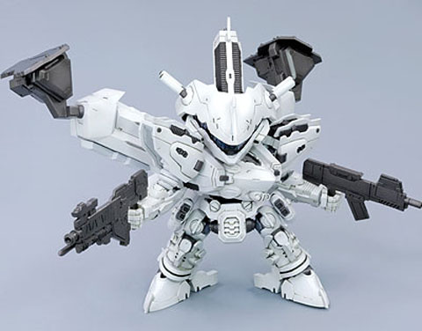
Cub Arts Direction SD

Slide 10
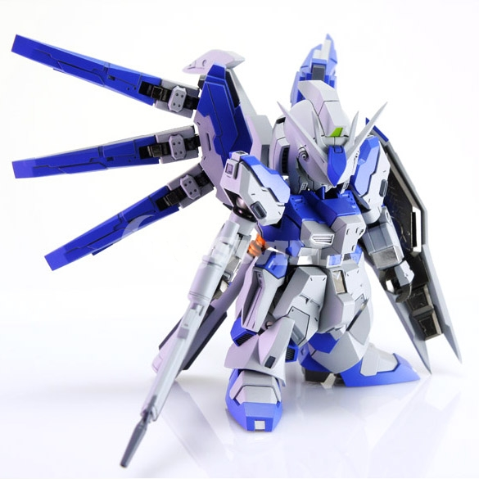
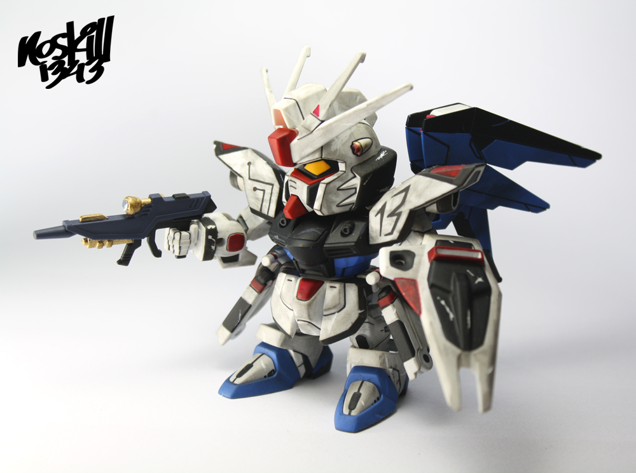
Cub Arts Direction SD

Slide 11
Realism

Slide 12
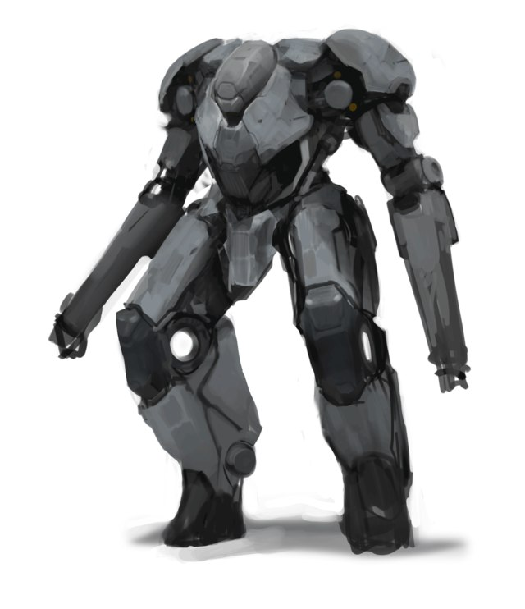
Cub Arts Direction Realism

Slide 13
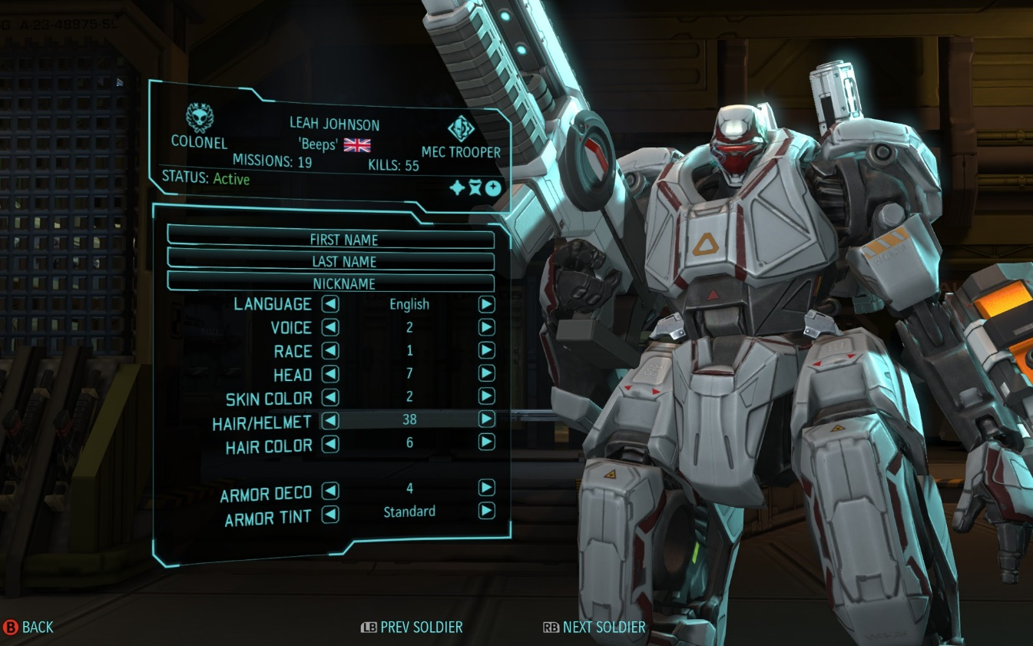
Cub Arts Direction Realism

Slide 14
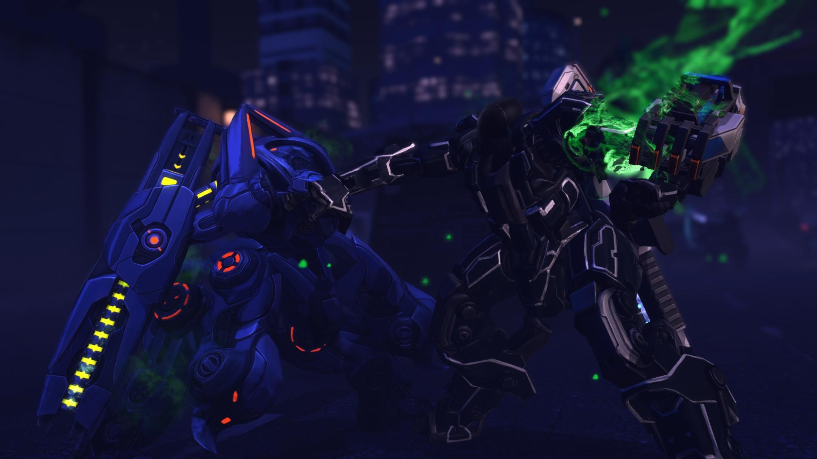
Cub Arts Direction Realism

Slide 15
Sprite

Slide 16
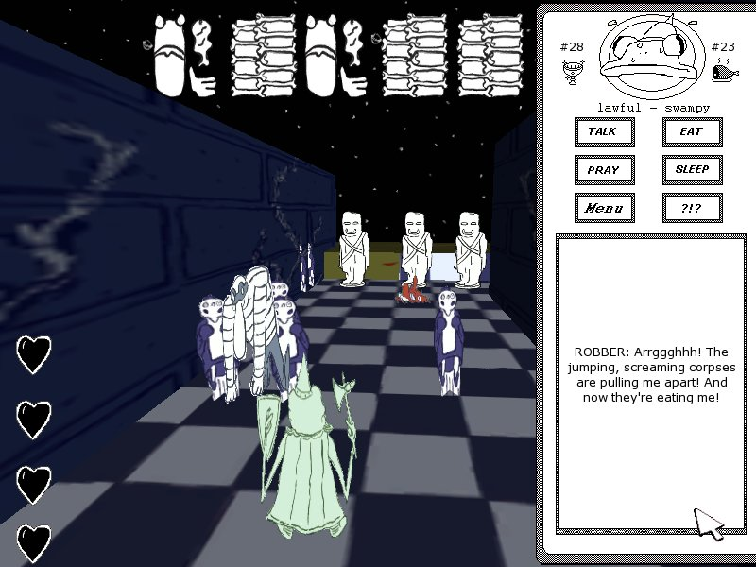
Cub Arts Direction Sprite

Slide 17
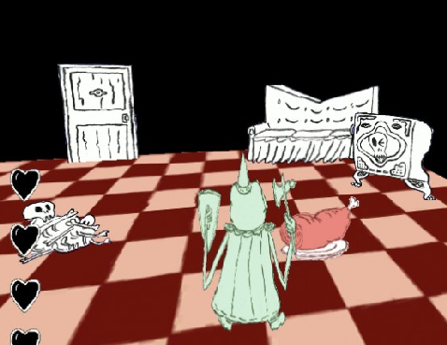
Cub Arts Direction Sprite

Slide 18
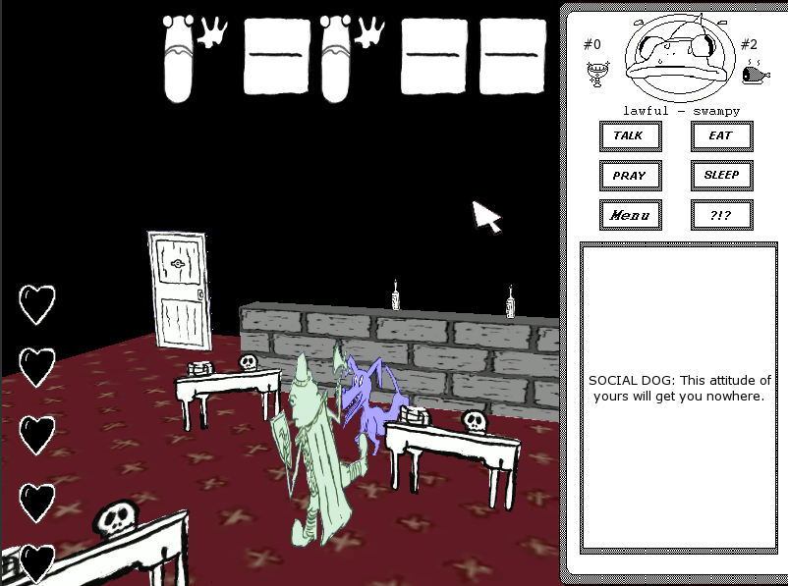
Cub Arts Direction Sprite

Slide 19
Thank You

